Slide 1


Do you have an « Instant » ?
Thomas Pierrain
@tpierrain
Notes:
J’aurai pu sous-titrer cette courte présentation : date/time formats and issues
Ou : pourquoi vous ne devez jamais utiliser le format DateTime
Déjà avant de commencer, je dois vous confesser que j’ai longtemps cru que de choisir le bon format de date était un sujet technique.
Il n’en est rien, et avec certains de mes anciens collègues, on a été confronté à tellement de cas compliqués et tordus, que je me suis dit que ce serait utile de vous partager quelques leçons apprises à la dure à l’époque.

Slide 2

Once Upon a time
Notes:
C’était dans les années 2010 dans une grande banque d’investissement.
Celle-ci était en gros coupée en 2 …
====
https://www.google.com/url?sa=i&url=https%3A%2F%2Fwww.lesechos.fr%2Ffinance-marches%2Fbanque-assurances%2Fsociete-generale-accelere-le-tri-dans-ses-filiales-internationales-240664&psig=AOvVaw24NtP0Ko5jWKQzfWucnylu&ust=1631595349576000&source=images&cd=vfe&ved=0CAkQjRxqFwoTCMiPjtSU-_ICFQAAAAAdAAAAABAD

Slide 3

Once upon a time
Notes:
Même si vous me connaissez comme VP Eng chez Agicap, j’ai longtemps travaillé dans la finance de marché en tant que dev, tech lead, archi.
La plupart des systèmes sur lesquels j’ai pu travailler étaient des systèmes 24/7 (follow the Sun), et j’avoue avoir un peu galéré au début avec

Slide 4
Challenge #7
Is U.T.C. enough?
Notes:
Store precise timestamps in UTC but it may not be sufficient if you need to keep intentions such as “June 8 2PM London time in 2 years”. UTC alone is a snapshot of what you saw when you pick a date time.

Slide 5

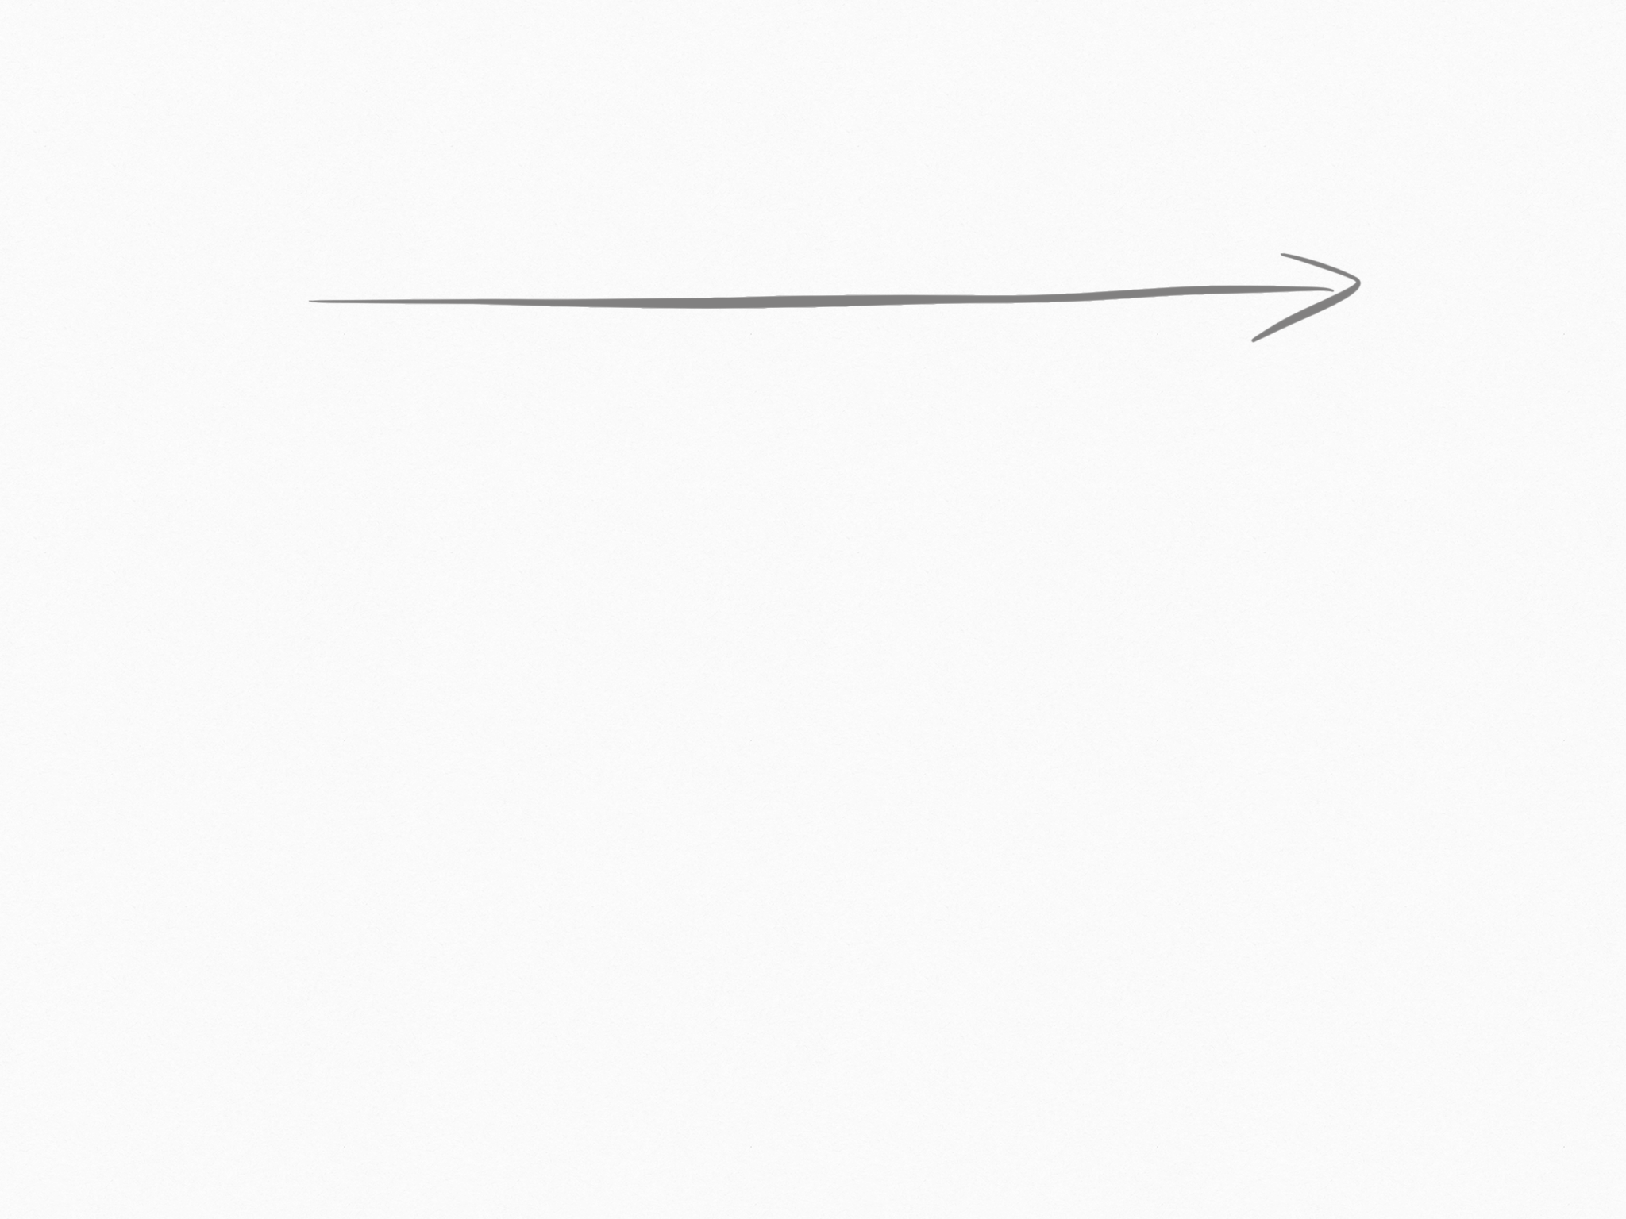
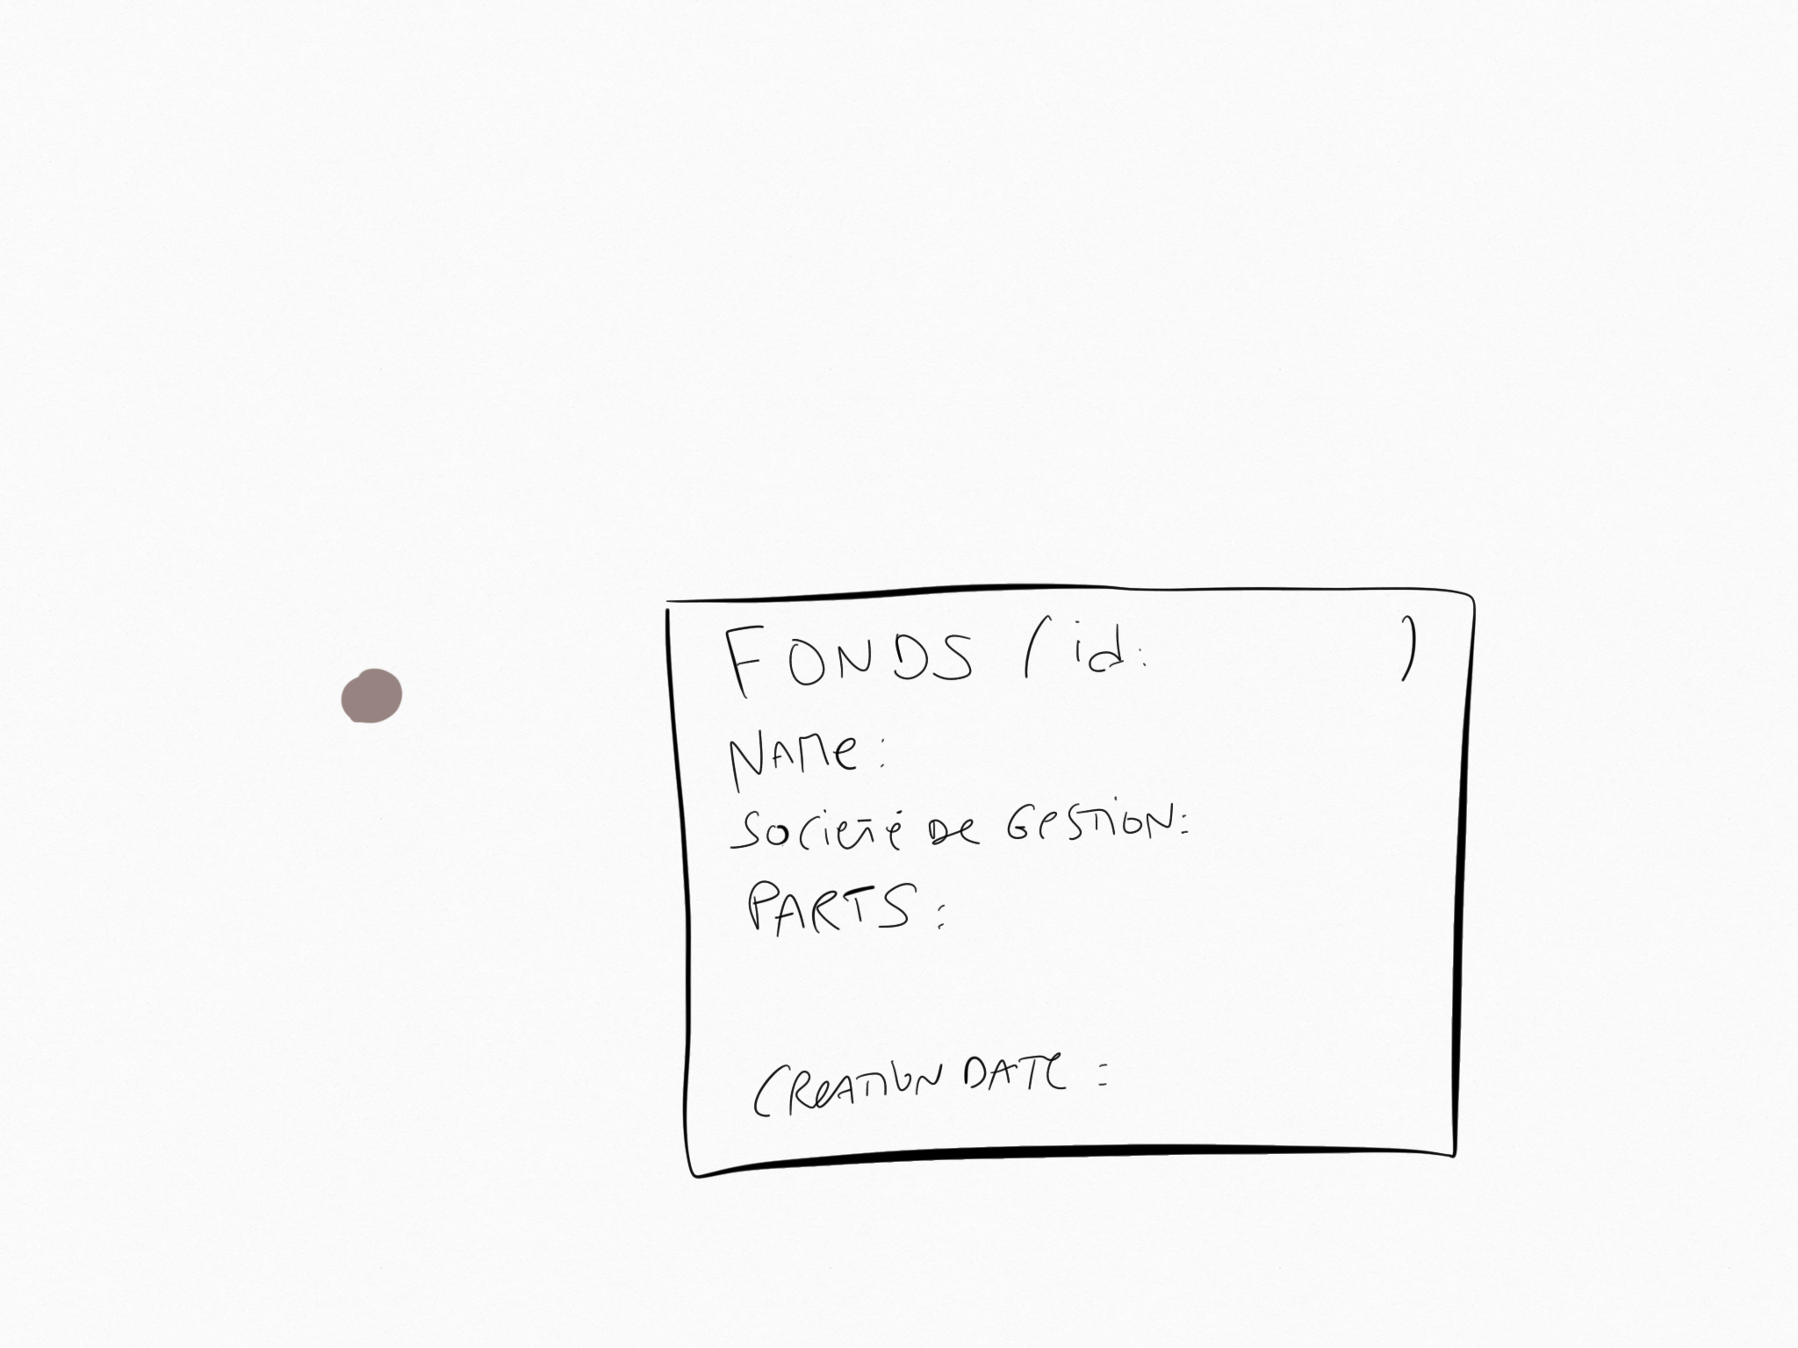
t
Challenge #7
We store instants in our Event Store (createdAt, validFrom timestamps)
Some events are applied on an entire “day” (e.g. June 8th)
Notes:
to override previous ones' impacts

Slide 6
t
Challenge #7
We store instants in our Event Store (createdAt, validFrom timestamps)
Some events are applied on an entire “day” (e.g. June 8th)
Which timestamps should we pick to describe a “day”?
Notes:
to override previous ones' impacts

Slide 7

t
Challenge #7
We store instants in our Event Store (createdAt, validFrom timestamps)
Some events are applied on an entire “day” (e.g. June 8th)
Which timestamps should we pick to describe a “day”?
Is UTC enough to store all instants?
Notes:
to override previous ones' impacts

Slide 8
UTC [Utéçé;-)]
Universal Time Coordinated is the primary time standard by which the world regulates clocks and time. It does not observe daylight saving time.

Slide 9
Instant [ˈçaAriiiv]
Describes “when something happened”. Can then be interpreted in a particular time zone and calendar system.
e.g.: 2018-05-18T16:40:35Z (Z means UTC, i.e. +00h)

Slide 10
What does June 8th even mean?
Istanbul (+03)

Slide 11
What does June 8th even mean?
Istanbul (+03)
Paris (+02)

Slide 12
What does June 8th even mean?
Istanbul (+03)
Paris (+02)
UTC (+00)

Slide 13
What does June 8th even mean?
Jun 8th 2018
00h (+ 03h)
Jun 8th 2018
23h59 (+ 03h)
Istanbul (+03)
Paris (+02)
UTC (+00)

Slide 14
What does June 8th even mean?
Jun 8th 2018
00h (+ 03h)
Jun 8th 2018
23h59 (+ 03h)
Istanbul (+03)
Paris (+02)
UTC (+00)
Jun 7th 2018
21h (+ 00h)
Jun 8th 2018
21h59 (+ 00h)

Slide 15
What does June 8th even mean?
Jun 8th 2018
00h (+ 03h)
Jun 8th 2018
23h59 (+ 03h)
Istanbul (+03)
Jun 8th 2018
00h (+ 02h)
Jun 8th 2018
23h59 (+ 02h)
Paris (+02)
UTC (+00)
Jun 7th 2018
21h (+ 00h)
Jun 8th 2018
21h59 (+ 00h)

Slide 16
What does June 8th even mean?
Jun 8th 2018
00h (+ 03h)
Jun 8th 2018
23h59 (+ 03h)
Istanbul (+03)
Jun 8th 2018
00h (+ 02h)
Jun 8th 2018
23h59 (+ 02h)
Paris (+02)
UTC (+00)
Jun 7th 2018
22h (+ 00h)
Jun 8th 2018
21h59 (+ 02h)
Jun 7th 2018
21h (+ 00h)
Jun 8th 2018
21h59 (+ 00h)

Slide 17

Should event 1 be involved in a June 8th projection?
Istanbul (+03)
Paris (+02)
Event 1 ?
UTC (+00)
Jun 7th 2018
21h (+ 00h)
Jun 7th 2018
22h (+ 00h)
Jun 8th 2018
21h59 (+ 00h)
Jun 8th 2018
21h59 (+ 02h)

Slide 18
only if it’s June 8th - Paris time
Istanbul (+03)
Paris (+02)
Event 1?
UTC (+00)
Jun 7th 2018
21h (+ 00h)
Jun 7th 2018
22h (+ 00h)
Jun 8th 2018
21h59 (+ 00h)
Jun 8th 2018
21h59 (+ 02h)

Slide 19

June 8th Paris != June 8th Istanbul
Notes:
https://www.telegraph.co.uk/content/dam/Travel/Destinations/Europe/Turkey/Istanbul%20lead-xlarge.jpg

Slide 20
June 8th Paris time != June 8th Istanbul time
Istanbul (+03)
Paris (+02)
UTC (+00)
Jun 7th 2018
21h (+ 00h)
Jun 7th 2018
22h (+ 00h)
Jun 8th 2018
21h59 (+ 00h)
Jun 8th 2018
21h59 (+ 02h)

Slide 21
UTC Time is mandatory to store & compare events
Istanbul (+03)
Paris (+02)
UTC (+00)
Jun 7th 2018
21h (+ 00h)
Jun 7th 2018
22h (+ 00h)
Jun 8th 2018
21h59 (+ 00h)
Jun 8th 2018
21h59 (+ 02h)

Slide 22
UTC is mandatory but not enough
Istanbul (+03)
Paris (+02)
UTC (+00)
Jun 7th 2018
21h (+ 00h)
Jun 7th 2018
22h (+ 00h)
Jun 8th 2018
21h59 (+ 00h)
Jun 8th 2018
21h59 (+ 02h)

Slide 23
We need UTC Time + time zone of the event

Slide 24
time zone of the event?

Slide 25
time zone of the event?
Time zone of the action that originated the event?

Slide 26
time zone of the event?
Time zone of the action that originated the event?
Time zone associated with the topic (i.e. a Fund)?

Slide 28
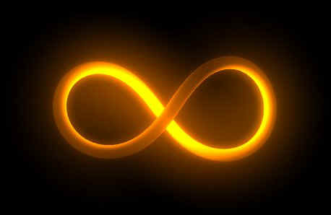
- Wrap up -
Notes:
http://astronomienfolie.free.fr/images_univers/conclusion.jpg

Slide 29
1 Forward-only projections with filters
2 Sort - then - Apply events
not compliant with big streams of events
3 Rebased Timelines with branches
too complicated

